Slide 1

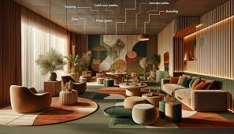



Avion
Presented By: Uzma Ahmed GIAIC Roll No # 00448632

Slide 2

Business Pitch: Furniture & Crockery E-Commerce Website 1. Business Overview Company Name: Avion Industry: E-Commerce (Furniture & Crockery) Business Model: Online Marketplace for high-quality furniture and crockery. Presented By: Uzma Ahmed GIAIC Roll No # 00448632
Avion

Slide 3
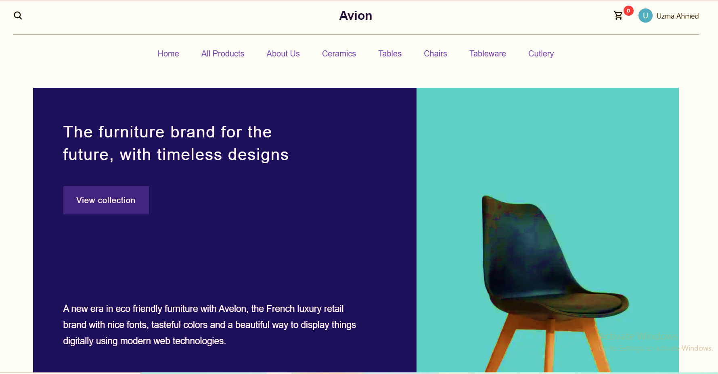
Avion
About the Business:
Our e-commerce platform provides customers with a premium selection of furniture and crockery, offering a seamless shopping experience. We aim to bridge the gap between traditional furniture shopping and modern e-commerce convenience.

Slide 4
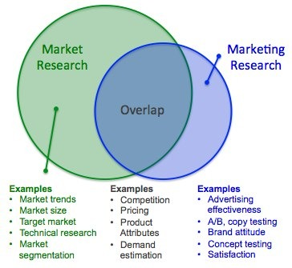
2. Market Research
Avion
Target Audience:
Homeowners looking for stylish and durable furniture.
Restaurants and cafes needing bulk crockery.
Interior designers searching for high-quality decor pieces.
Newlyweds and families setting up new homes.
Competitive Advantage:
Unique, handpicked furniture and crockery collections.
Affordable pricing with premium quality.
Customization options for furniture designs.
Free delivery and easy return policies.
Market Trends:
Increasing demand for online home decor shopping.
Consumers prefer durable, sustainable, and stylish furniture.
Growth in smart kitchenware and modern crockery trends.

Slide 5
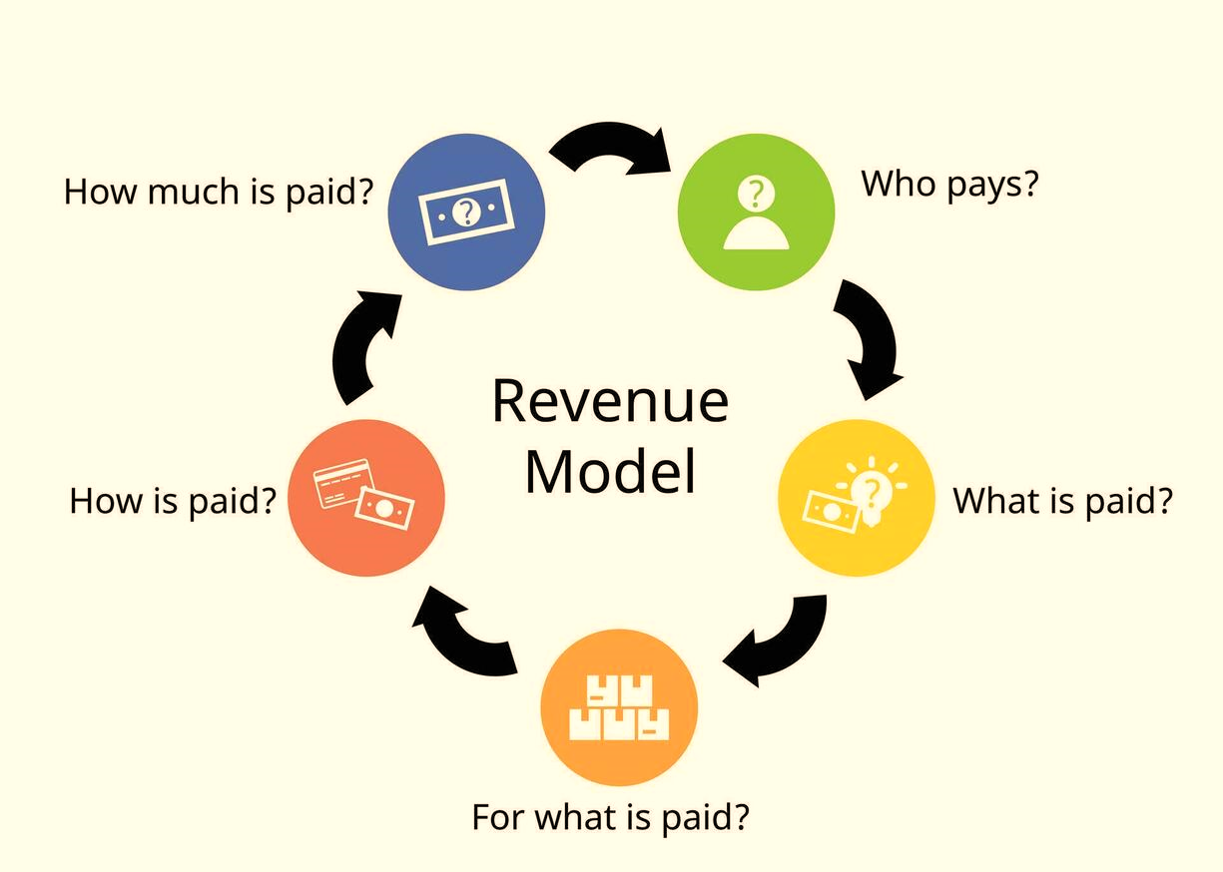
Avion
3. Revenue Model
Direct Product Sales (Furniture & Crockery)
Bulk Orders for Restaurants & Hotels
Subscription Plans for Exclusive Discounts
Email marketing campaigns for customer retention.

Slide 6

4. Marketing & Branding Strategy
Avion
Online Presence & Digital Marketing:
SEO-optimized website to drive organic traffic.
Social media marketing (Instagram, Facebook, Pinterest) showcasing product designs.
Influencer collaborations to reach a broader audience.
Email marketing campaigns for customer retention.
Advertising Channels:
Google Ads & Facebook Ads for targeted promotion.
YouTube and Instagram Reels showcasing product quality.
Partnership with home decor bloggers and interior designers.

Slide 7


5. Technology & Security
Avion
4. Marketing & Branding Strategy
Built using Next.js 14.2.2 for fast performance and scalability.
Secure payment gateways (Stripe, PayPal, etc.).
SSL encryption for data protection.
User-friendly UI/UX for seamless shopping.

Slide 8
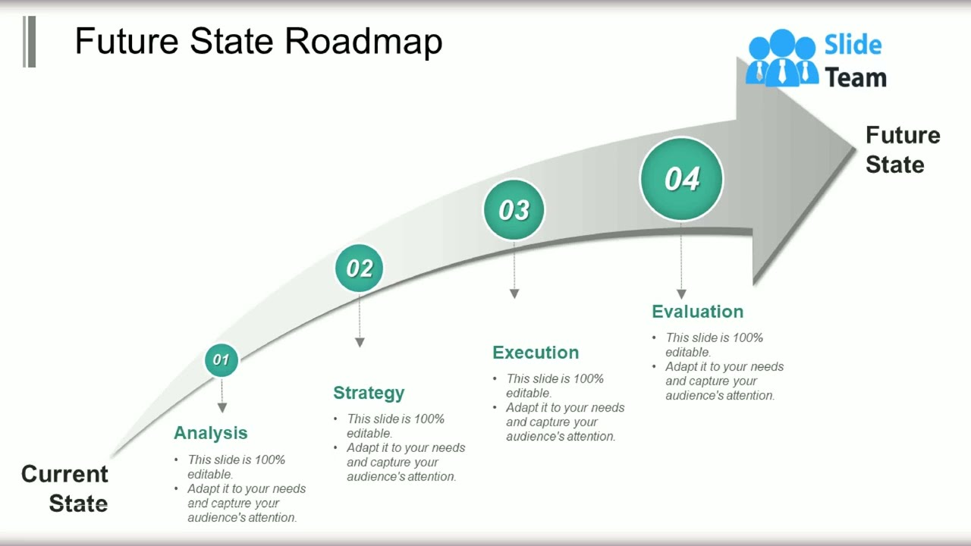
6. Future Roadmap
Avion
Mobile App Development to enhance customer experience.
International Shipping to expand market reach.
Augmented Reality (AR) Integration for virtual furniture placement.
Partnerships with Local Artisans for unique collections.

Slide 9

7. Funding & Investment
Avion
Seeking funding to scale operations and marketing efforts.
Investment required for inventory expansion and logistics.
Revenue-sharing or equity-based funding opportunities.

Slide 10

8. Conclusion
Avion
Our e-commerce platform aims to revolutionize the online furniture and crockery shopping experience. With a strong business model, targeted marketing strategy, and future expansion plans, we are set to become a leading player in the industry.

